Slide 1
Numerical questions on
Module 1
Types of Data Analysis
Kaustubh Kulkarni

Slide 2
Descriptive Analysis
Measures of central tendency
Measures of dispersion
IQR, Box Plot
Histograms, pie charts and other visualization tools to understand and analyse the historic data
You can refer to your notes of PSOT and IDS or the following chapters for the above topics:
https://online.stat.psu.edu/stat200/lesson/2
https://online.stat.psu.edu/stat200/lesson/3

Slide 3
Diagnostic Analysis
Correlation Analysis (Pearson Correlation Coefficient) for Root Cause Analysis
Pareto Analysis (80/20 Rule)
Failure Mode and Effects Analysis (FMEA)
Statistical Process Control (SPC)
Hypothesis Testing

Slide 4
Correlation for Root Cause Analysis
Example: Sales Performance Root Cause Analysis
Variables: Sales Performance, Training Hours, Market Conditions, Team Size, Experience
Variable | Sales | Training | Market | Team_Size | Experience
Sales | 1.00 | 0.78 | 0.65 | 0.34 | 0.82
Training | 0.78 | 1.00 | 0.23 | 0.45 | 0.56
Market | 0.65 | 0.23 | 1.00 | 0.12 | 0.38
Team_Size | 0.34 | 0.45 | 0.12 | 1.00 | 0.28
Experience | 0.82 | 0.56 | 0.38 | 0.28 | 1.00

Slide 5
Correlation for Root Cause Analysis
Example: Sales Performance Root Cause Analysis
Variables: Sales Performance, Training Hours, Market Conditions, Team Size, Experience
Variable | Sales | Training | Market | Team_Size | Experience
Sales | 1.00 | 0.78 | 0.65 | 0.34 | 0.82
Training | 0.78 | 1.00 | 0.23 | 0.45 | 0.56
Market | 0.65 | 0.23 | 1.00 | 0.12 | 0.38
Team_Size | 0.34 | 0.45 | 0.12 | 1.00 | 0.28
Experience | 0.82 | 0.56 | 0.38 | 0.28 | 1.00
Root Cause Ranking by Correlation:
Experience: r = 0.82 (Strong positive correlation)
Training: r = 0.78 (Strong positive correlation)
Market Conditions: r = 0.65 (Moderate positive correlation)
Team Size: r = 0.34 (Weak positive correlation)
Coefficient of Determination (R²):
Experience: R² = 0.82² = 0.67 (67% of sales variance explained)
Training: R² = 0.78² = 0.61 (61% of sales variance explained)

Slide 6
Pareto Analysis (80/20 Rule)
Principle: The Pareto Principle is an observed phenomenon which states that 80% of effects result from 20% of causes.
The principle helps in pinpointing the critical few causes that contribute most to a problem, allowing for targeted interventions.
By identifying the vital few, diagnostic analysis can prioritize efforts and resources on addressing the most impactful factors, leading to more efficient solutions.

Slide 7
Formula:
Cumulative Percentage =
(Σ Frequency up to item i / Total Frequency) × 100
Example: Customer Complaint Analysis
Complaint Type | Frequency
Long Wait Times | 245
Rude Staff | 156
Billing Errors | 89
Poor Communication | 67
Facility Issues | 45
Other | 38

Slide 8
Example: Customer Complaint Analysis
Complaint Type | Frequency | Percentage
Long Wait Times | 245 | 38.3%
Rude Staff | 156 | 24.4%
Billing Errors | 89 | 13.9%
Poor Communication | 67 | 10.5%
Facility Issues | 45 | 7.0%
Other | 38 | 5.9%

Slide 9
Example: Customer Complaint Analysis
Complaint Type | Frequency | Percentage | Cumulative %
Long Wait Times | 245 | 38.3% | 38.3%
Rude Staff | 156 | 24.4% | 62.7%
Billing Errors | 89 | 13.9% | 76.6%
Poor Communication | 67 | 10.5% | 87.1%
Facility Issues | 45 | 7.0% | 94.1%
Other | 38 | 5.9% | 100.0%

Slide 10
Complaint Type | Frequency | Percentage | Cumulative %
Long Wait Times | 245 | 38.3% | 38.3%
Rude Staff | 156 | 24.4% | 62.7%
Billing Errors | 89 | 13.9% | 76.6%
Poor Communication | 67 | 10.5% | 87.1%
Facility Issues | 45 | 7.0% | 94.1%
Other | 38 | 5.9% | 100.0%
Pareto Principle Application:
Vital Few: Top 2 causes (Wait Times + Rude Staff) = 62.7% of complaints
Trivial Many: Bottom 4 causes = 37.3% of complaints
Focus Area: Address top 2 causes to eliminate 63% of complaints

Slide 11
Failure Mode and Effects Analysis (FMEA)
FMEA scoring system:
Risk Priority Number (RPN) = Severity × Occurrence × Detection
Where each factor is rated 1-10:-
Severity: Impact of failure (1=minor, 10=catastrophic)
Occurrence: Frequency of failure (1=rare, 10=very frequent)
Detection: Ability to detect before impact (1=always detected, 10=never detected)

Slide 12
Example: Hospital Emergency Department Wait Time Analysis
Failure Mode | Severity | Occurrence | Detection
Staff Shortage | 8 | 7 | 3
Equipment Failure | 9 | 4 | 2
System Downtime | 7 | 5 | 2
Supply Shortage | 6 | 3 | 4
Patient Surge | 8 | 6 | 5

Slide 13
Example: Hospital Emergency Department Wait Time Analysis
Failure Mode | Severity | Occurrence | Detection | RPN | Priority
Staff Shortage | 8 | 7 | 3 | 168 | 1
Equipment Failure | 9 | 4 | 2 | 72 | 2
System Downtime | 7 | 5 | 2 | 70 | 3
Supply Shortage | 6 | 3 | 4 | 72 | 2
Patient Surge | 8 | 6 | 5 | 240 | 1

Slide 14
FMEA Calculations
Staff Shortage RPN = 8 × 7 × 3 = 168
Patient Surge RPN = 8 × 6 × 5 = 240
Total Risk Score = Σ(RPN) = 168 + 72 + 70 + 72 + 240 = 622
Risk Distribution:
High Risk (RPN > 100): Patient Surge (38.6%), Staff Shortage (27.0%)
Medium Risk (RPN 50-100): Equipment Failure (11.6%), Supply Shortage (11.6%)
Low Risk (RPN < 50): System Downtime (11.3%)

Slide 15
Statistical Process Control
A control chart monitors a process variable over time – e.g., the time to get to work.
The average is calculated after you have sufficient data.
The control limits are calculated – an upper control limit (UCL) and a lower control limit (LCL).
The UCL is the largest value you would expect from a process with just common causes of variation present.
The LCL is the smallest value you would expect with just common cause of variation present.
If the all the points are within the limits and there are no patterns, only common causes of variation are present. The process is said to be “in control.”
Upper Control Limit (UCL) = μ + 3σ
Lower Control Limit (LCL) = μ - 3σ
6σ spread

Slide 16
Example
Emergency department wait times (minutes): 45, 52, 38, 61, 49, 55, 43, 58, 46, 50.
Calculate the control limits and identify if any points are out of control.
μ = (45 + 52 + 38 + 61 + 49 + 55 + 43 + 58 + 46 + 50) / 10 = 49.7 minutes
σ = √[(45-49.7)² + (52-49.7)² + ... + (50-49.7)²] / 9 = 7.18 minutes
UCL = 49.7 + 3(7.18) = 71.2 minutes
LCL = 49.7 - 3(7.18) = 28.2 minutes
No points are out of control

Slide 17
Unsolved Example: Quality control data for defect rates (%): 2.1, 3.4, 1.8, 4.2, 2.9, 3.1, 2.7, 3.8, 2.3, 2.9, 3.5, 2.4 Calculate the control limits and identify if any points are out of control.

Slide 18
Technique | Diagnostic Role
Correlation Analysis (Pearson) | Shows linear relationship between variables — helps in identifying possible causes.
Hypothesis Testing | Evaluates assumptions (e.g., is the difference in means significant?) — identifies statistically valid drivers of observed behavior.
Pareto Analysis (80/20 Rule) | Helps find vital few causes behind majority of problems — classic diagnostic tool.
Correlation Matrix for Root Cause | Broadens correlation analysis to multiple variables — helpful for uncovering multivariate influences.
FMEA (Failure Mode and Effects Analysis) | Systematic approach to identifying potential failures and causes — highly diagnostic, especially in manufacturing or engineering data.
Statistical Process Control (SPC) | Monitors process behavior — if abnormal variation is detected, SPC leads to root cause analysis (diagnostic goal).

Slide 19
Predictive Analysis
Linear Regression
Logistic Regression
Probability distributions (shared separately within Module 1 material on classroom)
Naïve Bayes classification (shared separately within Module 1 material on classroom)
Other classification algorithms (ML course, Sem 6)
Time Series Analysis (Module 4)

Slide 20
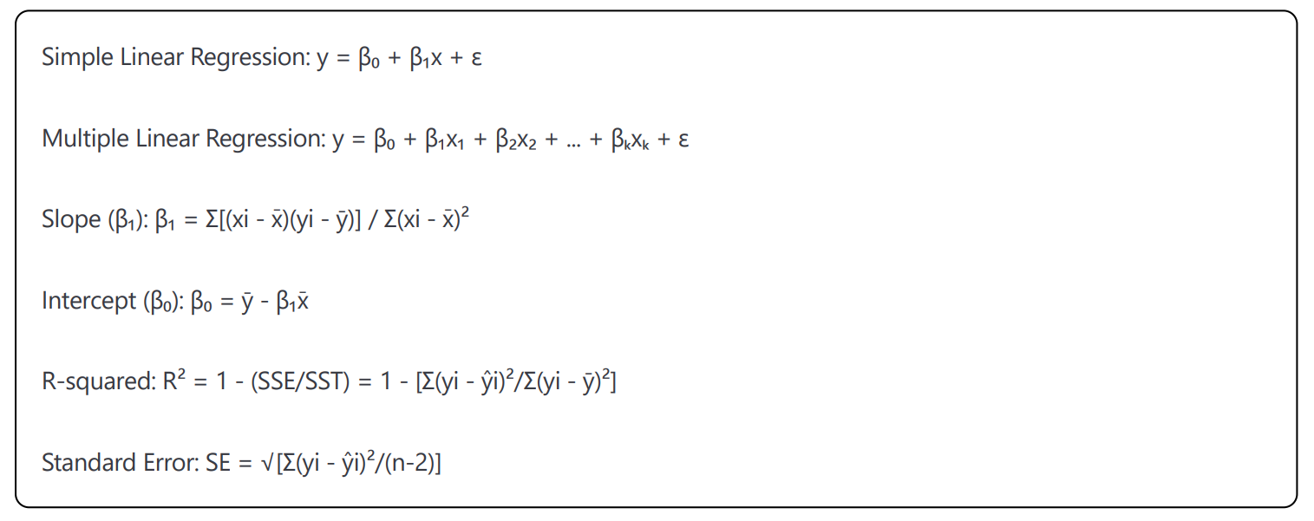
Linear Regression Formulas

Slide 21
Solved Example: House price prediction
Area of the house in sq. ft. (x) vs. House price in USD (y)
Data: (1000, 150k), (1200, 180k), (1400, 210k), (1600, 240k), (1800, 270k)
Predict the price for a 1500 sq.ft. house

Slide 22
Solution
x̄ = 1400, ȳ = 210
Σ(xi - x̄)(yi - ȳ) = (-400)(-60) + (-200)(-30) + (0)(0) + (200)(30) + (400)(60) = 60,000
Σ(xi - x̄)² = 400,000
β₁ = 60,000 / 400,000 = 0.15 (price increases $150 per sq ft)
β₀ = 210 - 0.15(1400) = 0
Equation: Price = 0.15 × Size For 1500 sq ft: Price = 0.15 × 1500 = $225,000

Slide 23
Unsolved Example: Sales Forecasting
Monthly advertising spend (x) vs sales revenue (y)
Data: (5k, 50k), (8k, 65k), (12k, 85k), (15k, 95k), (20k, 120k)
Calculate the regression equation and predict sales for $18k advertising spend.

Slide 24
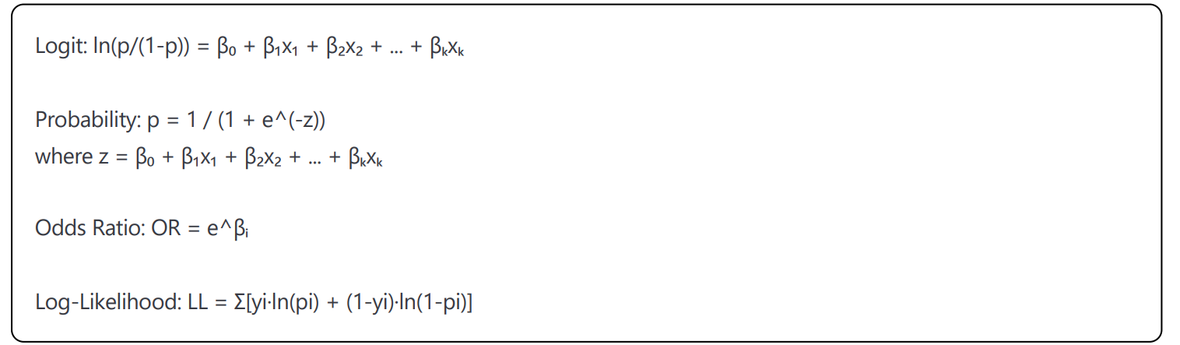
Logistic Regression Formulas

Slide 25
Solved Example:
Customer churn prediction
A logistic regression model is trained on a telco customer data that has the features : tenure which is the number of years the customer has stayed with the company and monthly charges which is the amount charged to the customer monthly. Following coefficients are obtained from the model:
β₀ = -1.2 (intercept)
β₁ = 0.5 (coefficient for tenure in years)
β₂ = 0.3 (coefficient for monthly charges in $100s)
For a customer with tenure = 2 years and monthly charges = $80, find the probability that the customer will switch to another operator (churn)

Slide 26
Solution
z = -1.2 + 0.5(2) + 0.3(0.8) = -1.2 + 1.0 + 0.24 = 0.04
p = 1 / (1 + e^(-0.04)) = 1 / (1 + 0.96) = 0.51 or 51%
Odds = p/(1-p) = 0.51/0.49 = 1.04
Odds ratio for tenure: e^0.5 = 1.65
(each additional year increases odds by 65%)

Slide 27
Unsolved Example
Email spam detection model:
ln(p/(1-p)) = 2.1 - 0.8x₁ + 1.5x₂
where x₁ = sender reputation score (0-10) and x₂ = suspicious keywords count
Calculate spam probability for an email with sender reputation = 6 and suspicious keywords = 2.

Slide 28
Prescriptive Analysis
Linear Programming to solve optimization problems given the objective function and constraints.

Slide 29
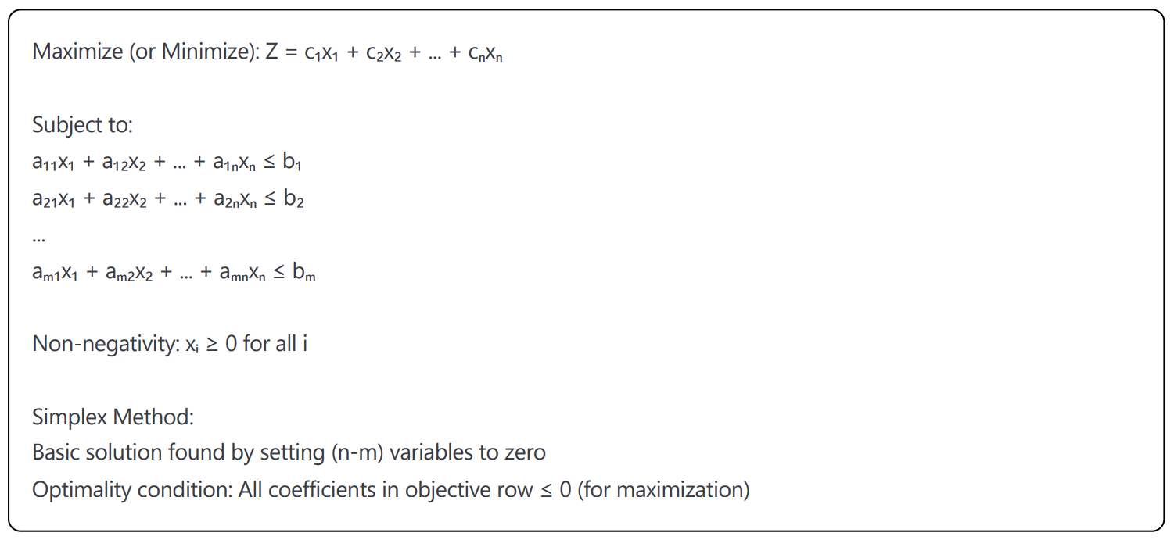
Standard Linear Programming Form

Slide 30
Solved Example
Production planning problem:
Maximize profit: Z = 40x₁ + 30x₂
Subject to: 2x₁ + x₂ ≤ 100 (material constraint)
x₁ + 2x₂ ≤ 80 (labor constraint)
x₁, x₂ ≥ 0

Slide 31
Solution
Corner points:
(0,0): Z = 0
(0,40): Z = 1200
(50,0): Z = 2000
Intersection:
2x₁ + x₂ = 100 and x₁ + 2x₂ = 80
Solving: x₁ = 40, x₂ = 20
Z = 40(40) + 30(20) = 2200
Optimal solution: x₁ = 40, x₂ = 20, Z = 2200

Slide 32
Unsolved Example
Diet optimization problem:
Minimize cost: Z = 0.5x₁ + 0.3x₂ + 0.8x₃
Subject to:
3x₁ + 2x₂ + 4x₃ ≥ 24 (protein)
x₁ + 3x₂ + 2x₃ ≥ 18 (vitamins)
x₁, x₂, x₃ ≥ 0
Find the optimal solution.

